Slide 1
Ensembles & Combining Intelligence
Geoff Hulten

Slide 2
Model Ensembles
Instead of learning one model, learn several (many) and combine them
Reasons:
Often improves accuracy, a lot
Organizes the process of doing ML on a team
Many methods
Bagging, Boosting, GBM, Random Forests, Stacking (Meta-models), sequencing, partitioning, etc…

Slide 3
Properties of Well-Organized Intelligence
Accurate
Easy to Grow
Loosely Coupled
Comprehensible
Measurable
Supportive of Team

Slide 4
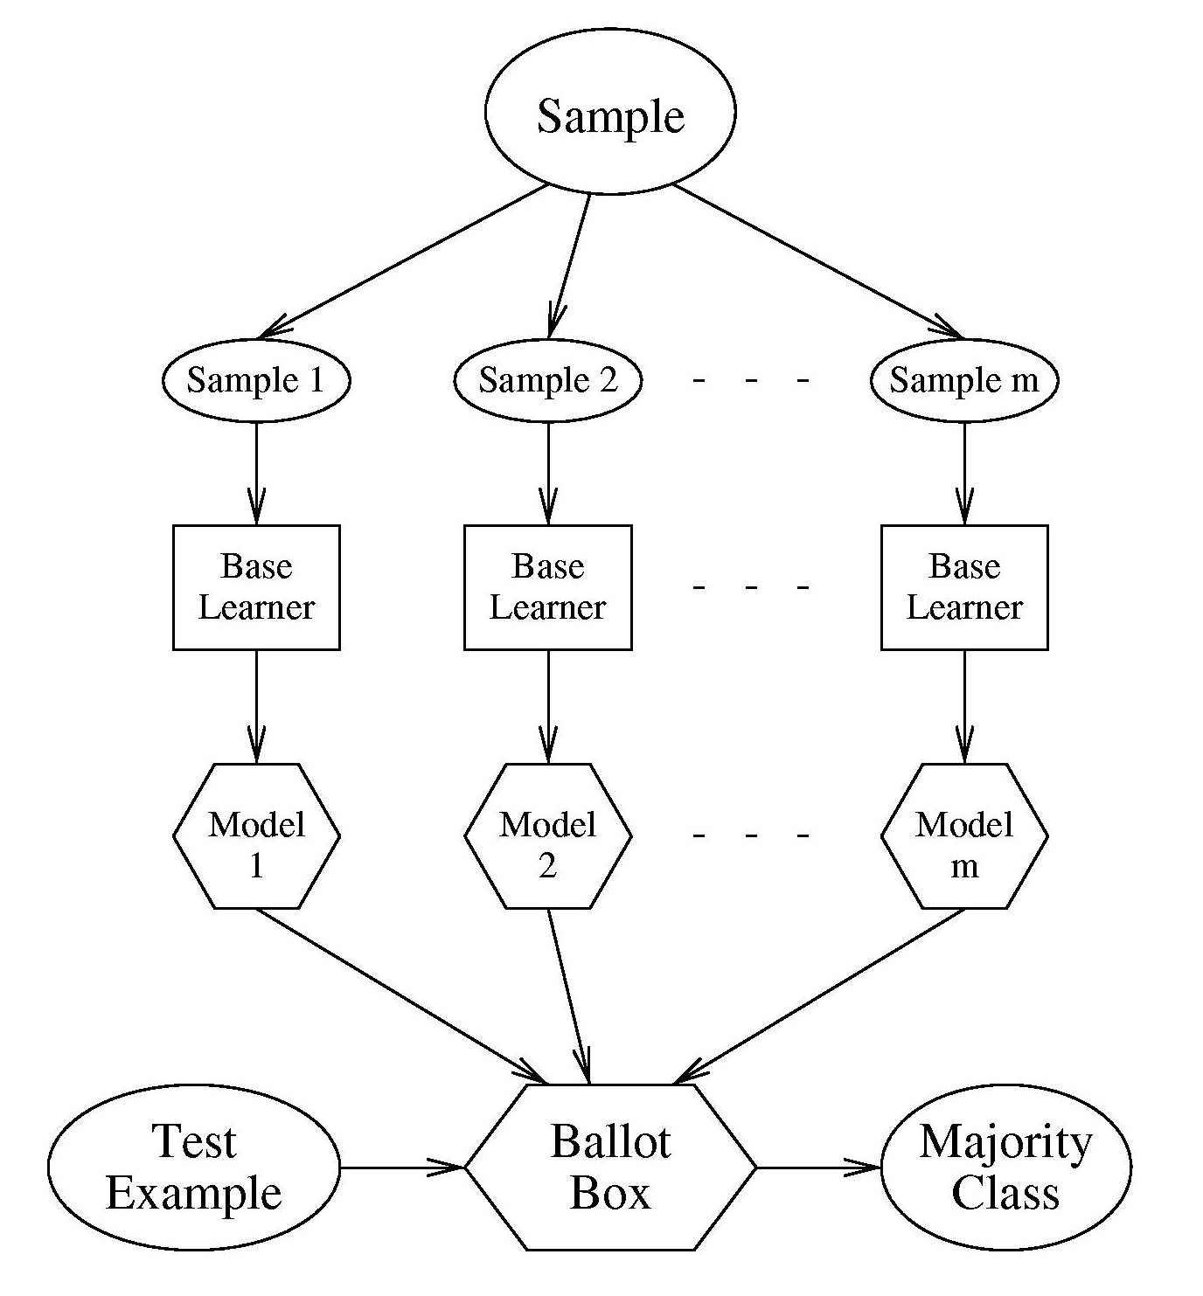
Bagging
Generate K training sets by sampling from the original training set
“Bootstrap” sample
Training set contains N training examples
Each of the K training sets also contains N training examples
Created by sampling with replacement from the original
Learn one model on each of the K training sets
Combine their predictions by uniform voting

Slide 5
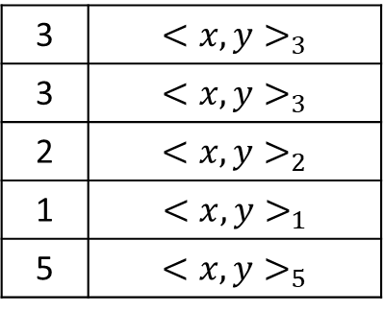
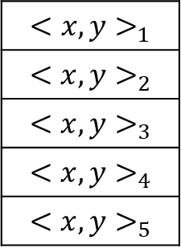
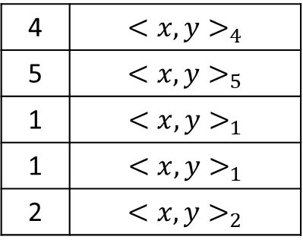
Bootstrap sampling – sampling with replacement
3 | $${<x,y>}_{3}$$
3 | $${<x,y>}_{3}$$
2 | $${<x,y>}_{2}$$
1 | $${<x,y>}_{1}$$
5 | $${<x,y>}_{5}$$
Most contain duplicates of the original
Most are missing some of the original samples -- ~37%
$${<x,y>}_{1}$$
$${<x,y>}_{2}$$
$${<x,y>}_{3}$$
$${<x,y>}_{4}$$
$${<x,y>}_{5}$$
Original Training Set
4 | $${<x,y>}_{4}$$
5 | $${<x,y>}_{5}$$
1 | $${<x,y>}_{1}$$
1 | $${<x,y>}_{1}$$
2 | $${<x,y>}_{2}$$

Slide 6
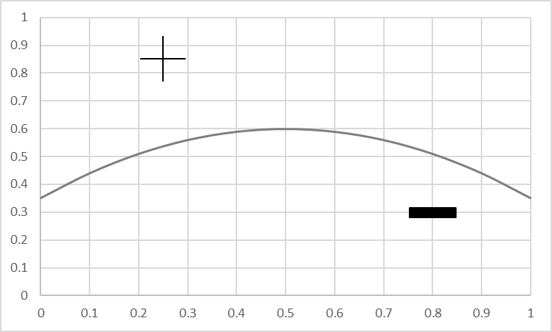
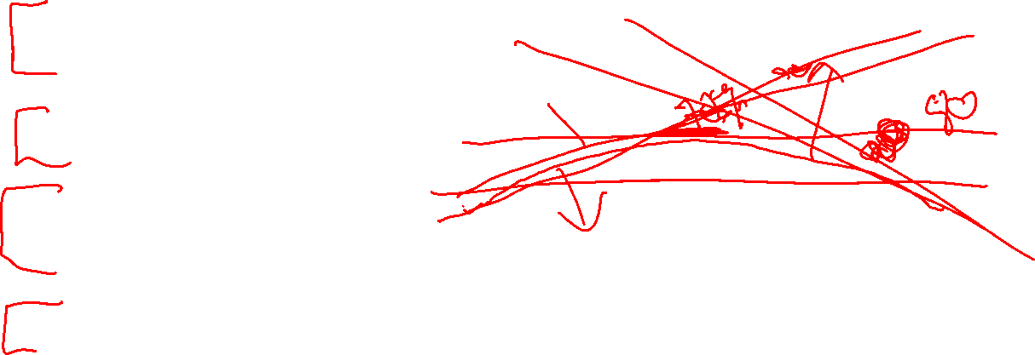
Advantages of Bagging
Each model focuses on a different part of the problem
Can fit that part of the problem better
Introduces variance between individual models
Voting tends to cancel out the variance

Slide 7
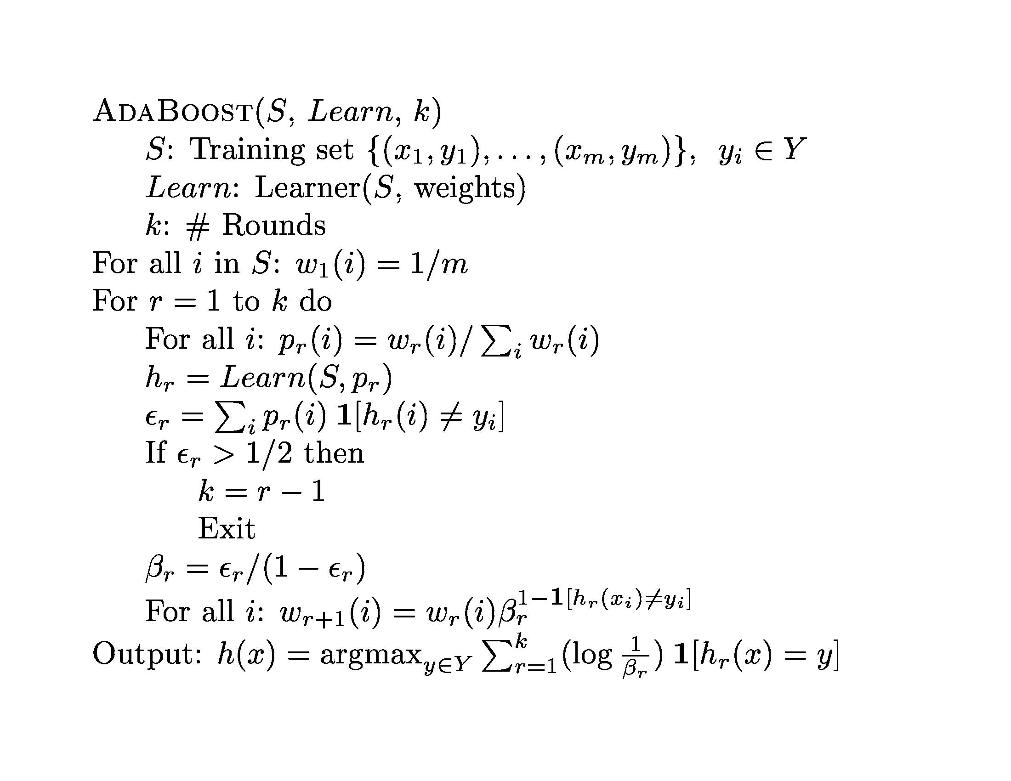
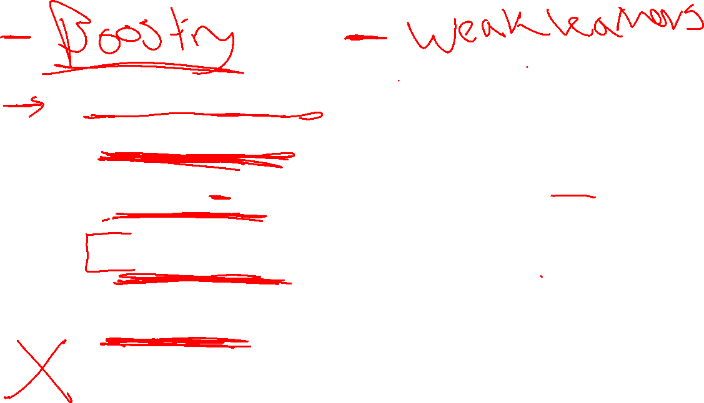
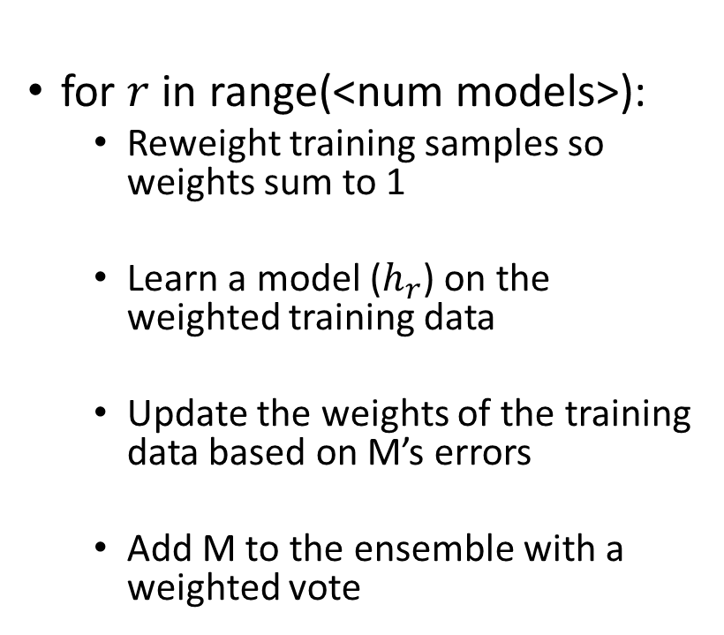
Boosting
for $r$ in range(<num models>):
Reweight training samples so weights sum to 1
Learn a model ($h_{r}$) on the weighted training data
Update the weights of the training data based on M’s errors
Add M to the ensemble with a weighted vote

Slide 8
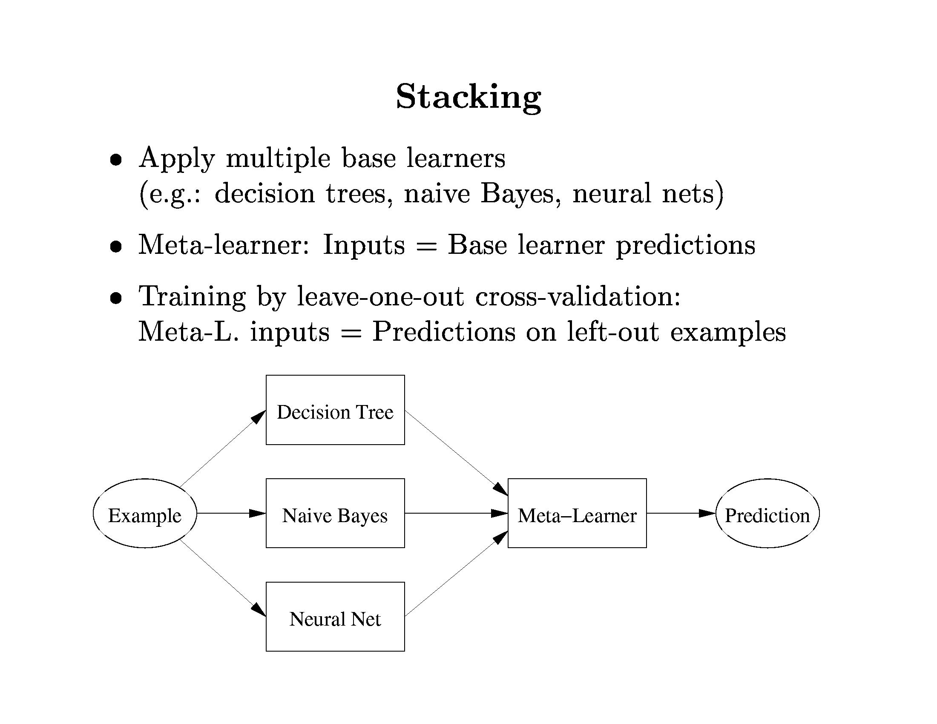
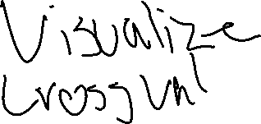
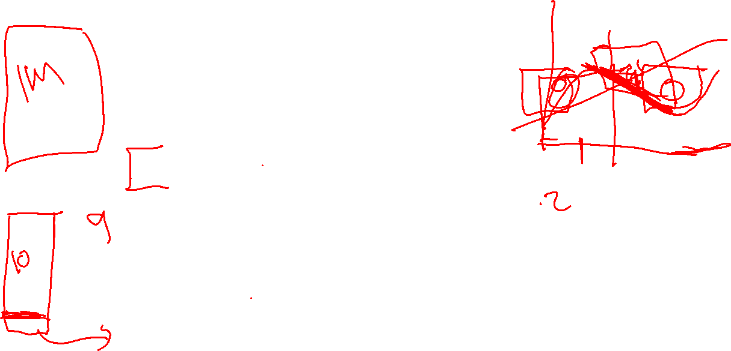

Slide 9
Random Forests
Build N trees
Bootstrap sample for each training set (Bagging)
Restrict the features each tree can use
Combine by uniform voting

Slide 10


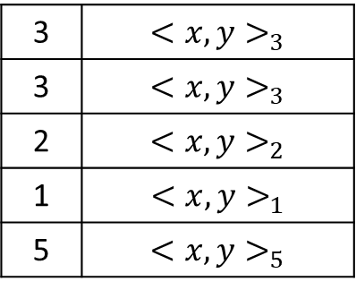



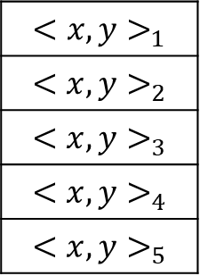






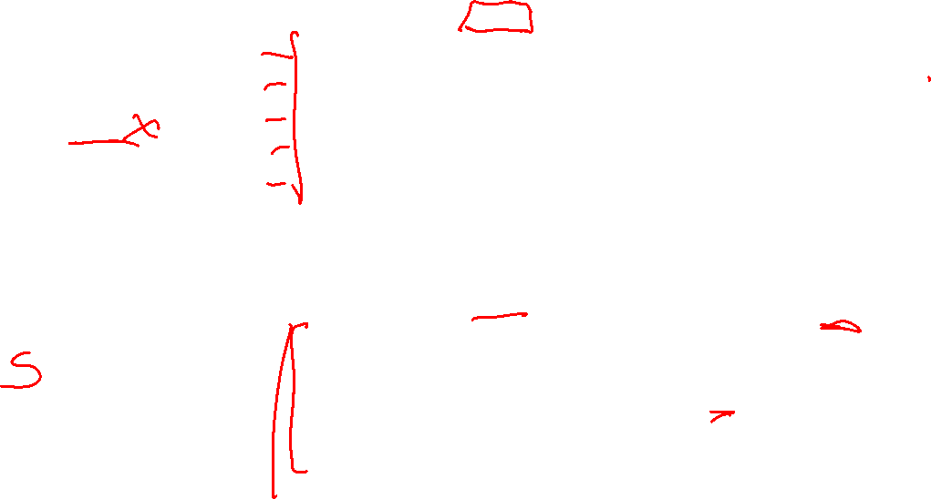
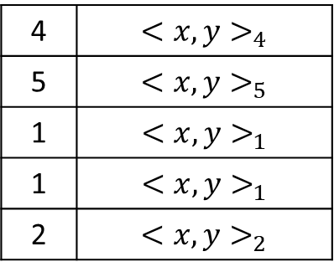


Example RandomForest Grow
Selected features: $x_{1} x_{2}$
$$x_{1}=1?$$
3 | $${<x,y>}_{3}$$
3 | $${<x,y>}_{3}$$
2 | $${<x,y>}_{2}$$
1 | $${<x,y>}_{1}$$
5 | $${<x,y>}_{5}$$
False
True
Grow Tree 1
$$y=1$$
$$x_{2}=1?$$
Features: $x_{1} x_{2}$ $x_{3}$
Tree 1
False
True
$${<x,y>}_{1}$$
$${<x,y>}_{2}$$
$${<x,y>}_{3}$$
$${<x,y>}_{4}$$
$${<x,y>}_{5}$$
$$y=1$$
$$y=0$$
Tree 2
Selected features: $x_{1} x_{3}$
$$x_{3}=1?$$
4 | $${<x,y>}_{4}$$
5 | $${<x,y>}_{5}$$
1 | $${<x,y>}_{1}$$
1 | $${<x,y>}_{1}$$
2 | $${<x,y>}_{2}$$
False
True
Grow Tree 2
$$x_{1}=1?$$
$$y=0$$
False
True
$$y=1$$
$$y=0$$

Slide 11


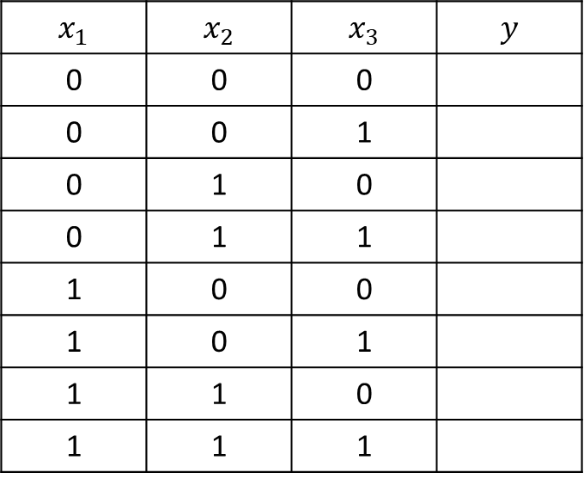














Example RandomForest Predict
$$x_{1}=1?$$
False
True
$$x_{2}=1?$$
False
True
$$x_{1}$$ | $$x_{2}$$ | $$x_{3}$$ | $$y$$
0 | 0 | 0
0 | 0 | 1
0 | 1 | 0
0 | 1 | 1
1 | 0 | 0
1 | 0 | 1
1 | 1 | 0
1 | 1 | 1
$$y=1$$
$$x_{2}=1?$$
False
True
$$y=0$$
$$y=1$$
$$y=1$$
$$y=0$$
$$x_{3}=1?$$
False
True
$$x_{3}=1?$$
False
True
$$x_{1}=1?$$
$$y=0$$
False
True
$$y=1$$
$$y=0$$
$$y=1$$
$$y=0$$

Slide 12
RandomForest Pseudocode
trees = []
for i in range(numTrees):
(xBootstrap, yBootstrap) = BootstrapSample(xTrain, yTrain)
featuresToUse = RandomlySelectFeatureIDs(len(xTrain), numToUse)
trees.append(GrowTree(xBootstrap, yBootstrap, featuresToUse))
yPredictions = [ PredictByMajorityVote(trees, xTest[i]) for i in len(xTest) ]
yProbabilityEstimates = [ CountVotes(trees, xTest[i]) / len(trees) for i in len(xTest) ]

Slide 13
Model Sequencing
Model 1
Model 2
Model 3
Model …
Override?
Override?
Override?
Override?
Default answer 0
Accurate
Easy to Grow
Loosely Coupled
Comprehensible
Measurable
Supportive of Team

Slide 14
Partitioning Contexts
Large Web Site?
No
Yes
Ensemble 1
Ensemble 2
Accurate
Easy to Grow
Loosely Coupled
Comprehensible
Measurable
Supportive of Team

Slide 15
Ensembles & Combining Intelligence Summary
Almost every practical ML situation has more than one model
One important reason is accuracy
Another is maintainability
Avoid ‘Spaghetti Intelligence’

